Slide 1
Insurance Company Expenses
Like every other business, insurance companies seek to minimize expenses associated with doing business in order to enhance profitability. To study expenses, we examine a random sample of 384 insurance companies from the National Association of Insurance Commissioners (NAIC) database of over 3,000 companies. The NAIC maintains one of the world’s largest insurance regulatory databases; we consider here data that is based on 2005 annual reports for all the property and casualty insurance companies in United States. The annual reports are financial statements that use statutory accounting principles.

Slide 2
GOAL
Our goal is to fit a suitable linear regression model that explains the expenses of the insurance companies
As part of your report present an exploratory data analysis along with the model built, stating clearly every step you take along with the reasons/justification for taking said steps
Marks will be awarded for your interpretations, remarks and suggestions rather than just the models and outputs
The description of each of the variable used in the dataset is given below

Slide 3
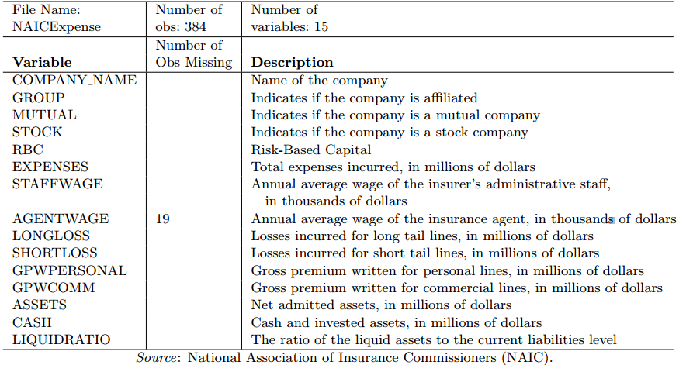
Variables

